Slide 1
Do Drug Combinations that Show Similar Activities also Show Similar Synergies?
Intern: Sarita Lee
Mentors: Raj Guha & Lu Chen

Slide 2
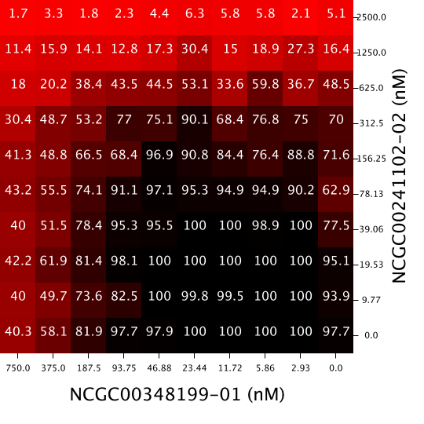
Introduction- Drug Combinations and Synergy
Response Matrix
Drug combinations are used to treat medical conditions
Sometimes drugs used together have a greater effect than what would be predicted based on their individual effects
Called a synergistic effect
Synergistic Effect- when the drug combination effect is different than the predicted effect based on the drugs’ individual effects
Drug Y
Drug X

Slide 3
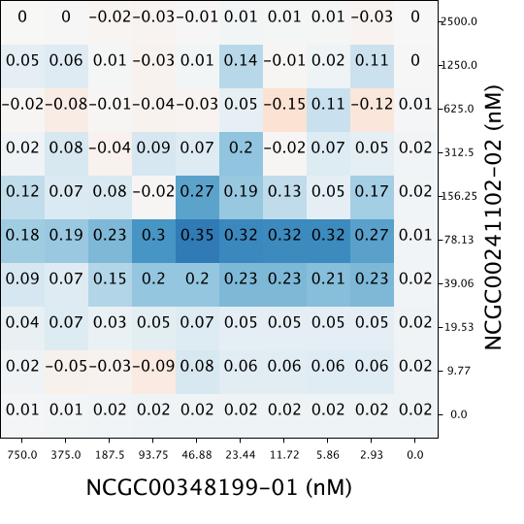
Introduction- Synergistic Effects
Currently, discovering synergistic drug combinations happens by accident, posing as a barrier on improving patient health
Predicting drug combinations effects would facilitate treatment development process
Response Matrix
Synergy Matrix

Slide 4
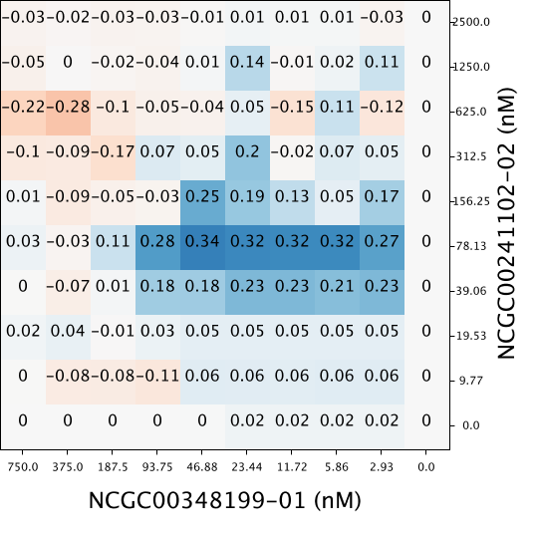
Introduction- Methods to Measure Synergy
Synergy Matrix-
HSA
Three Methods:
Highest Single Agent (HSA)- [more info here]
Bliss Independence Model- [more info here]
Loewe Additivity Model- [more info here]
Synergy Matrix-
Delta Bliss
Used Bliss Independent Model throughout all of project- [say why here ]

Slide 5
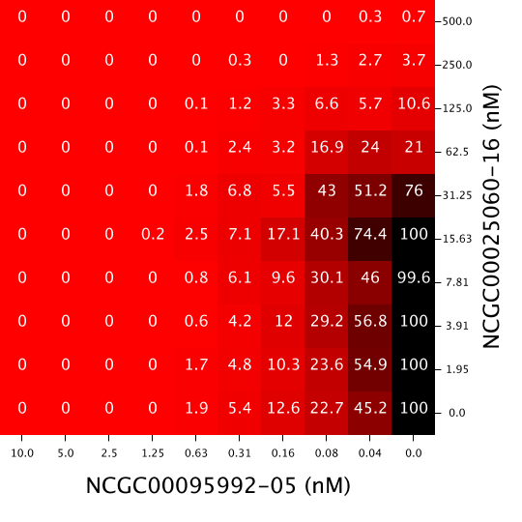
Overarching Questions
Question 1: What metric should be used to quantify dissimilarity (distance) between two matrices?
Question 2: Does activity correlate to synergy? How?
Drug Combo A -
Response Matrix
Drug Combo
B -
Response Matrix
Drug Combo
A -
Response Matrix
Drug Combo
A -
Delta Bliss Matrix

Slide 6
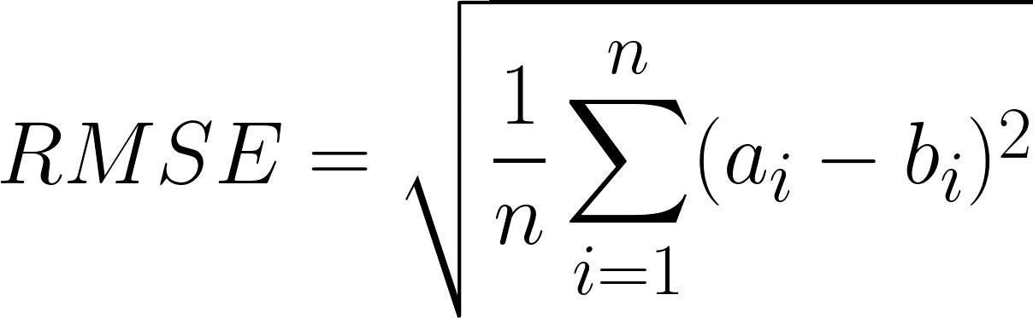
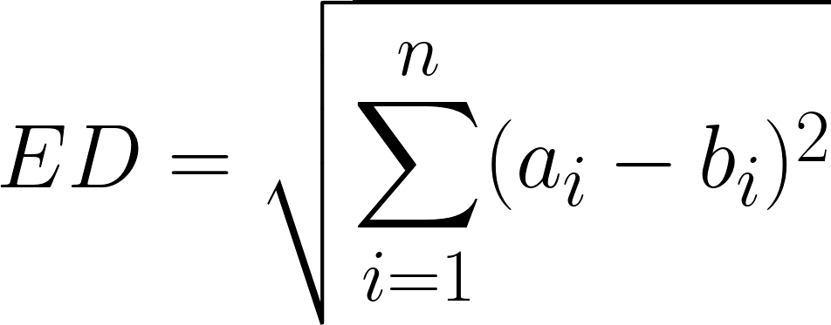
Question 1: Dissimilarity Metrics
Drug Combo A
Drug Combo B
Insensitive to Spatial Distribution
1. Root Mean Standard Error (RMSE)
2. Euclidean Distance (ED)
3. Two- Sample Kolmogorov-Smirnov Test (KS Test)
[explanation here]
Sensitive to Spatial Distribution
4. Syrjala Test
[explanation here]

Slide 7
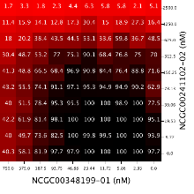
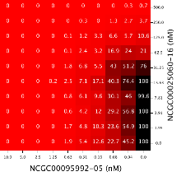
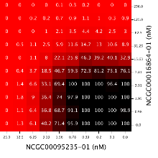
Question 1: Dissimilarity Metrics- Response Matrices in an Assay
Step 1: Compare one drug combination
to one other drug combination
Step 2: Compare one drug combination
to all other drug combinations
Step 3: Compare all drug combinations
to all other drug combinations

Slide 8
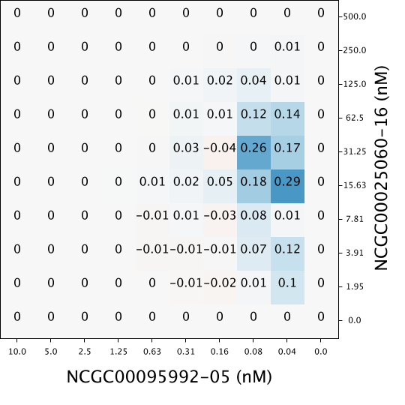
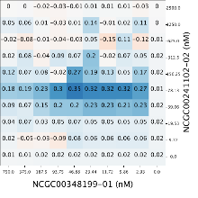

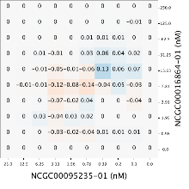
Question 1: Dissimilarity Metrics- Delta Bliss (Synergy) Matrices in an Assay
Step 1: Compare one drug combination
to one other drug combination
Step 2: Compare one drug combination
to all other drug combinations
Step 3: Compare all drug combinations
to all other drug combinations

Slide 9
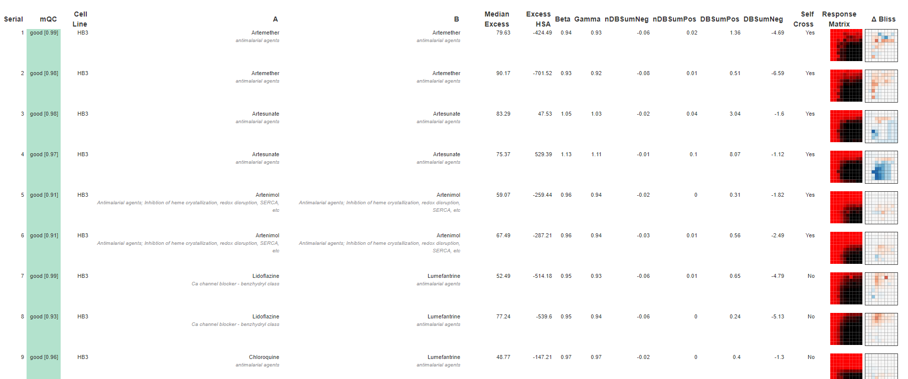
Question 1: Dissimilarity Metrics- Malaria Assay 1764 (480 Drug Combinations)
(First 9 drug combinations displayed; 480 total in the assay)

Slide 10
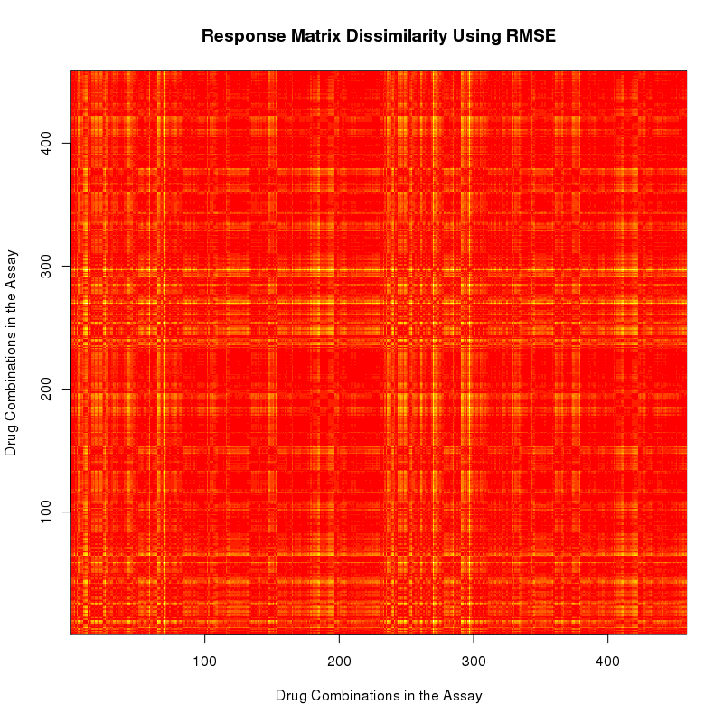
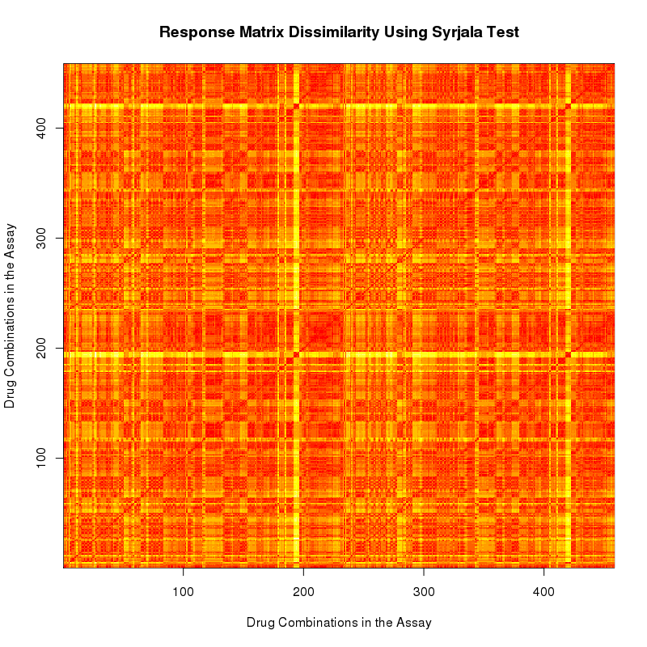
Question 1: Dissimilarity Metrics- Malaria Assay 1764 Response Matrices
RMSE
Syrjala Test

Slide 11
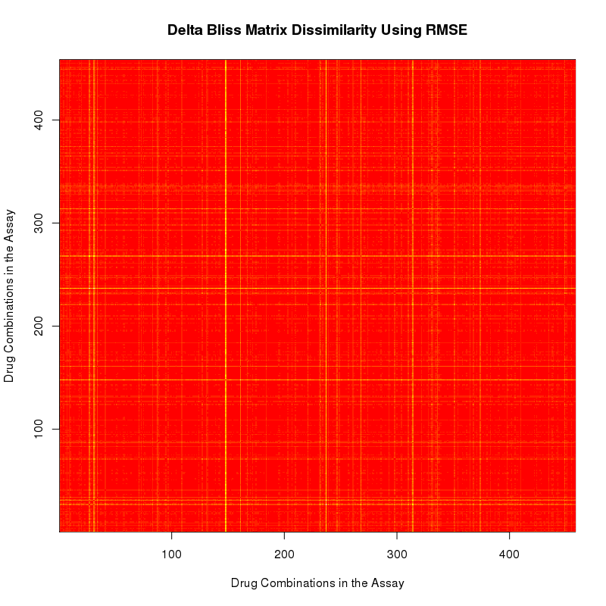
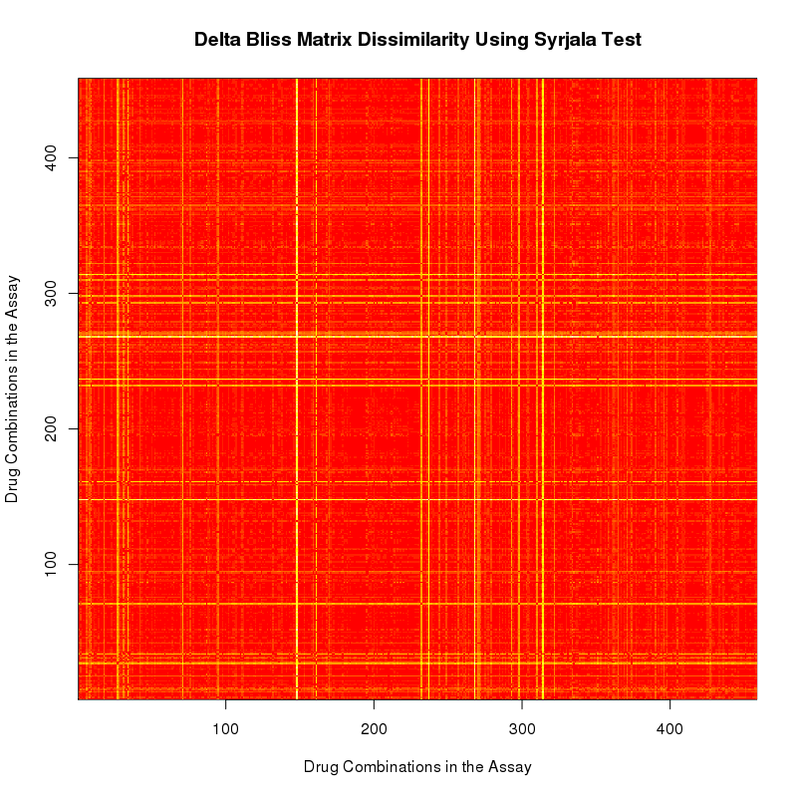
Question 1: Dissimilarity Metrics- Malaria Assay 1764 Delta Bliss Matrices
RMSE
Syrjala Test

Slide 12
Question 1: Dissimilarity Metrics- Malaria Assay 1764
Response Matrix Dissimilarity-
Syrjala Test
Delta Bliss (Synergy) Matrix Dissimilarity-
Syrjala Test
Do these correlate?

Slide 13
Overarching Questions
Question 1: What metric should be used to quantify dissimilarity between two matrices?
Question 2: Does activity correlate to synergy? How?
Drug Combo A -
Response Matrix
Drug Combo
B -
Response Matrix
Drug Combo
A -
Response Matrix
Drug Combo
A -
Delta Bliss Matrix

Slide 14
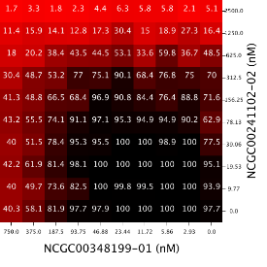



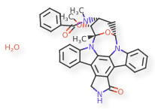
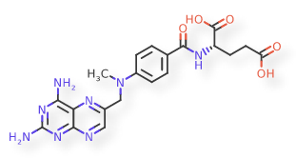
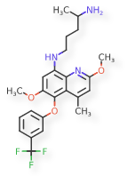
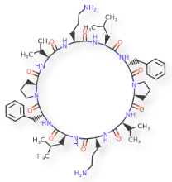
Question 2: Activity Correlated With Synergy
Part 1. Is there a correlation between the dissimilarity of response surfaces and the dissimilarity of the delta bliss (synergy) surfaces ?
Drug Combo
A
Drug Combo
A
Drug Combo
B
Drug Combo
B
Part 2. Is there a correlation between the dissimilarity of the compounds and the dissimilarity of the delta bliss (synergy) surfaces?

Slide 15
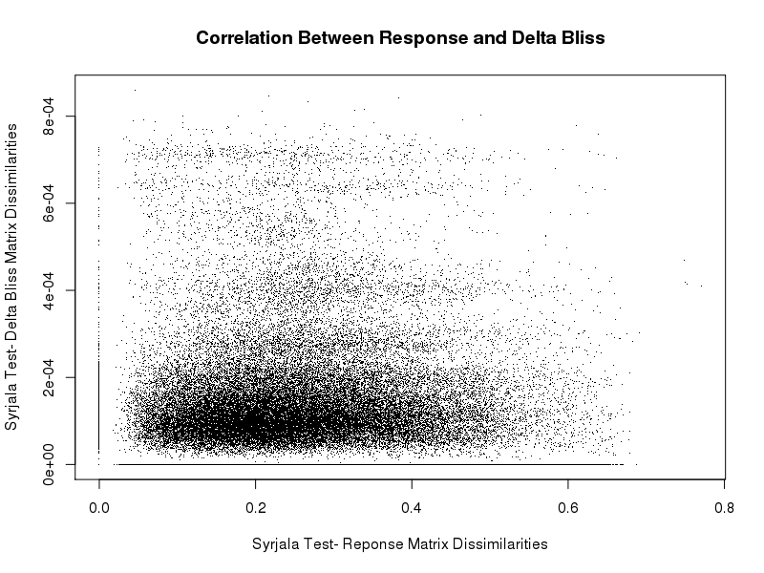
Question 2: Activity Correlated With Synergy- Response Surfaces vs Delta Bliss Surfaces

Slide 16
Question 2: Activity Correlated With Synergy- Dissimilarity of Compounds
Step 1. Compare one drug combination to another drug combination
Compare corresponding x agents
Compare corresponding y agents
Average those values
Step 2: Compare one drug combination to all other drug combinations
Step 3: Compare all drug combinations to all other drug combinations
x agents’ dissimilarity
y agents’ difference
Average difference

Slide 17
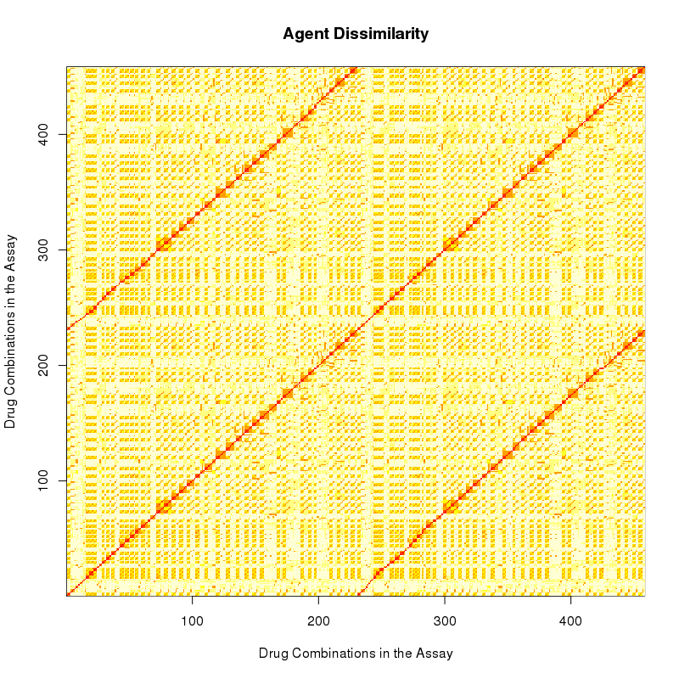
Question 2: Activity Correlated With Synergy- Malaria Assay 1764
Compound Dissimilarities
Response Matrix Dissimilarities-
Syrjala Test
Do these correlate?

Slide 18
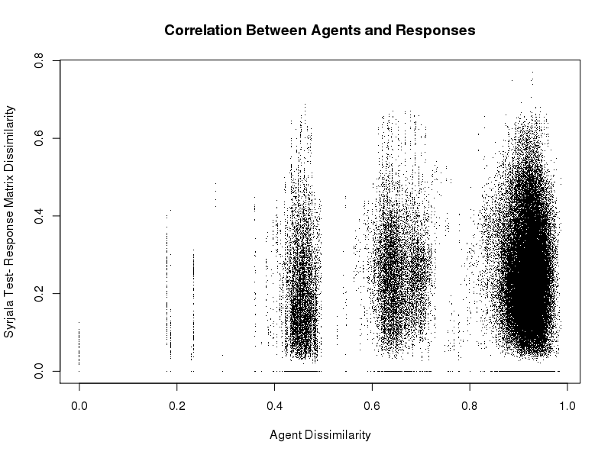
Question 2: Activity Correlated With Synergy- Compounds vs Response Surfaces

Slide 19
Question 2: Activity Correlated With Synergy- Malaria Assay 1764
Compound Dissimilarities
Delta Bliss (Synergy) Matrices-
Syrjala Test
Do these correlate?

Slide 20
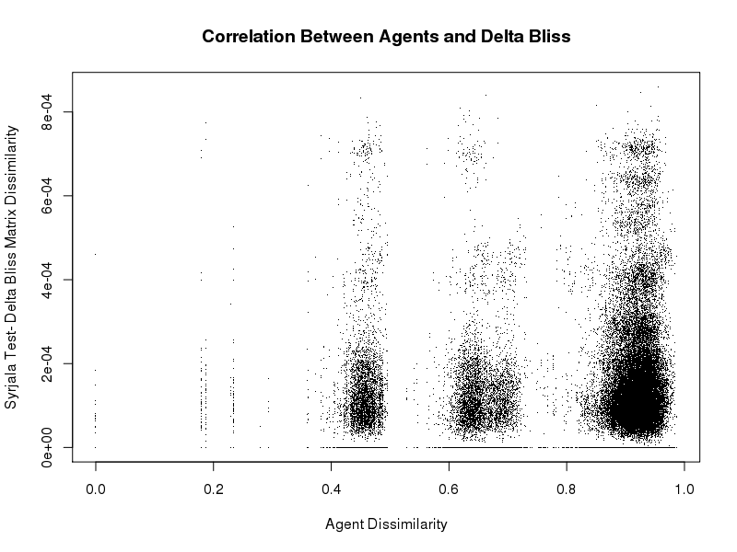
Question 2: Activity Correlated With Synergy- Compound Differences vs Delta Bliss Surfaces

Slide 21
[Discussion etc.]

